Slide 1

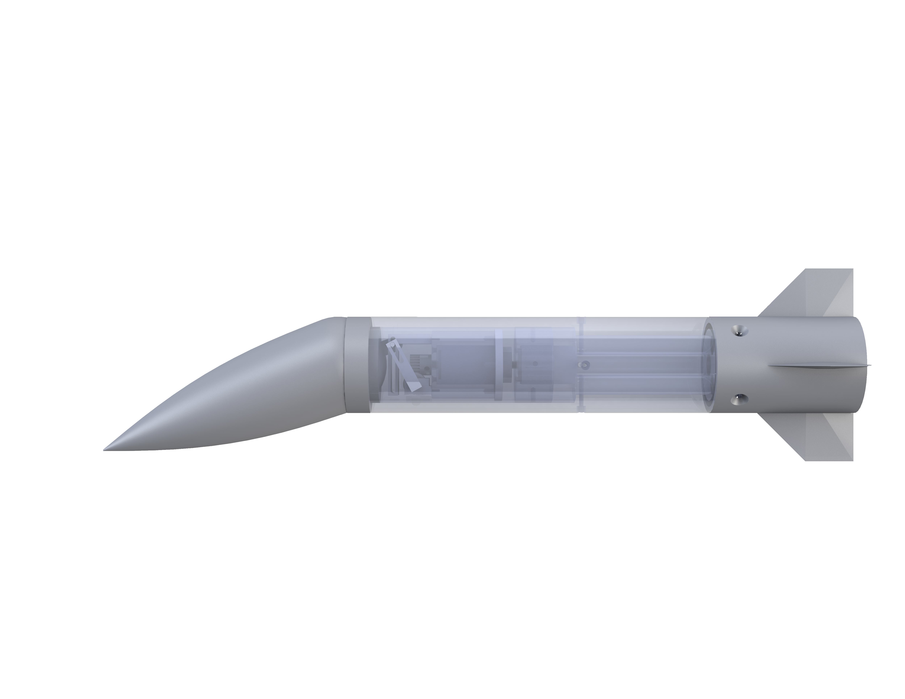
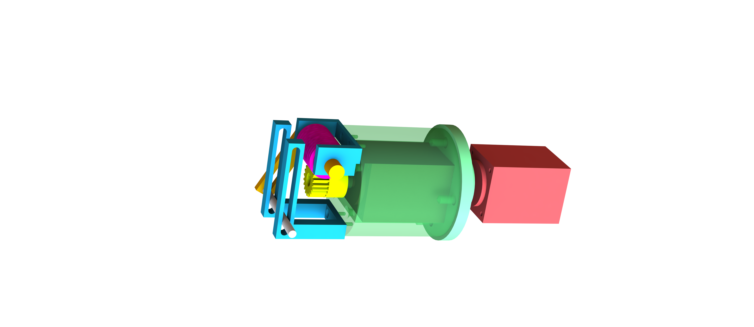

Articulating Nose Cone
Team 504: Jed Fazler, Noah Moffeit, Nicholas Samuda, Robert Smith
Project Objective:
Goals:
Design the method of articulation for a nose cone during testing in a low-speed wind tunnel while keeping a smooth edge transition
Articulate nose cone to pitch and yaw ±20°
Eliminate edge effects at the interface of the nose cone and body
Allow for user control of nose cone articulation
Components:
Background:
1
Worm Gear
FCAAP conducts wind tunnel tests for various companies
2
Spur Gear
3
Pin Slot Link
Looking to expand their testing capabilities with articulation during wind tunnel testing
1
4
6
4
Pin Holders
7
2
5
Sliding Pin
Articulating a nose cone may be a viable maneuverability alternative to fin deflection
6
3
Motor Mount
7
Stepper Motor
5
Project Start
Concept Selection
Prototyping
Testing
Machining & Assembly
CAD Work

